Slide 1
Blood, Toil, Tears and Sweat (May 13, 1940)
By Winston Churchill

Slide 2
1 Lead in-Quick reading!!
Quick in-class listening, reading and then synthesizing:
1) The biography/personal experience of Churchill
2）The historical background of the speech

Slide 3
2 Historical background
First Lord of the Admiralty…“longtime political enemy” of Prime Minister Neville Chamberlain
Nazi incursion in Norway with all confidence of success, but was defeated miserably
“Instead, all the pushing—and a lot of punching, hammering, rushing and blasting—had been done by the Germans. It was the British who went out backwards, faster than they had come in.” (Time)
Chamberlain, called to account for the failure…not a total disaster…many called for him to resign
The Labor Party refused to join a national coalition government unless Churchill was in charge of it.
Churchill took office as Prime Minister on May 10, 1940. On the 13th, he delivered this famous speech.

Slide 4
Result:
The House gave him a 381-to-0 vote of confidence.
Q1: Given the background, how would you respond to the British people/government memebers if you were in the position of Churchill?
Q2:
How did he do it?

Slide 5
1 Lead in
Pass the message

Slide 6
Pass the message
1. Danger gathers upon our path. We cannot to look back. We must look forward. ~Churchill, 10 December 1936
2. Our fight is hard. It will also be long. But win or lose, we must do our duty. ~Churchill, 18 March 1931
3. In politics when you are in doubt what to do, do nothing; when you are in doubt what to say, say what you really think.
~Churchill, 26 July 1905
4. We are still masters of our fate. We still are captain of our souls.
~House of Commons, 9 September 1941

Slide 7
Quotes of Winston Churchill
1. ‘United wishes and good will cannot overcome brute facts,’ Churchill wrote in his War Memoirs. ‘Truth is incontrovertible (无可辩驳的）. Panic may resent it. Ignorance may deride （嘲笑） it. Malice may distort it. But there it is.’
2. Danger gathers upon our path. We cannot afford – we have no right – to look back. We must look forward.
Churchill, 10 December 1936

Slide 8
3. Our fight is hard. It will also be long … But win or lose, we must do our duty. If the British people are to lose their Indian Empire, they shall do so with their eyes open.
Churchill, 18 March 1931
4. In politics when you are in doubt what to do, do nothing … when you are in doubt what to say, say what you really think.
Churchill, 26 July 1905

Slide 9
5. A year ago our position looked forlorn （孤立无助的）, and well nigh (几乎) desperate, to all eyes but our own. Today we may say aloud before an awe-struck world, ‘We are still masters of our fate. We still are captain of our souls.'”
—House of Commons, 9 September 1941

Slide 10
Listen to the Speech
First viewing: appreciation
Second viewing: fill in the gaps

Slide 11
On Friday evening last I received His Majesty’s (1) _________ to form a new (2) __________. It is the evident wish and will of Parliament and the nation that this should be conceived on the broadest possible basis and that it should include all parties. A War Cabinet has been formed of five Members, representing, with the Opposition Liberals, the (3) ________ of the nation. The three party Leaders have agreed to serve, either in the War (4) __________ or in high executive office. I now invite the House, by the Motion which stands in my name, to record its approval of the steps taken and to declare its confidence in the new Government.
It must be remembered that we are in the preliminary stage of one of the greatest (5) _________ in history, and many preparations have to be made here at home. I take up my task with (6) __________ and hope. I would say to the House, as I have said to those who have joined this government: “I have nothing to offer but (7) _________________________.”
We have before us an (8) ______ of the most grievous kind. We have before us many, many long months of (9) ________ and of suffering. You ask, what is our policy? I will say: It is to (10) __________, by sea, land, and air, with all our (11) _________ and with all the strength that God can give us; to wage war against a monstrous (12) __________, never surpassed in the dark, lamentable catalogue of human crime. That is our policy. You ask, what is our aim? I can answer in one word: Victory--victory at all costs, victory (13) ________________, victory, however long and hard the road may be; for without victory, there can be no (14) ___________.

Slide 12
On Friday evening last I received His Majesty’s (1) commission to form a new (2) Administration. It is the evident wish and will of Parliament and the nation that this should be conceived on the broadest possible basis and that it should include all parties. A War Cabinet has been formed of five Members, representing, with the Opposition Liberals, the (3) unity of the nation. The three party Leaders have agreed to serve, either in the War (4) Cabinet or in high executive office. I now invite the House, by the Motion which stands in my name, to record its approval of the steps taken and to declare its confidence in the new Government.
It must be remembered that we are in the preliminary stage of one of the greatest (5) battles in history, and many preparations have to be made here at home. I take up my task with (6) buoyancy and hope. I would say to the House, as I have said to those who have joined this government: “I have nothing to offer but (7)blood, toil, tears and sweat.”
We have before us an (8) ordeal of the most grievous kind. We have before us many, many long months of (9) struggle and of suffering. You ask, what is our policy? I will say: It is to (10) wage war, by sea, land, and air, with all our (11) might and with all the strength that God can give us; to wage war against a monstrous (12) tyranny, never surpassed in the dark, lamentable catalogue of human crime. That is our policy. You ask, what is our aim? I can answer in one word: Victory--victory at all costs, victory (13) in spite of all terrors, victory, however long and hard the road may be; for without victory, there can be no (14) survival.

Slide 13
3 Analyze the rhetorical situation --From Churchill’s perspective
The term first used by Lloyd Bitzer (1968)
“Rhetoric”: an ability, in each particular case, to identify the available means of persuasion (Aristotle)
Rhetorical situation are:
--The sender (or the rhetor)
--The receiver (or the audience)
--The message (or the delivered language)
--The objective/purpose
--The exigence (the overall context)
As Aristotle described it, the rhetorical situation is “the ability to observe in any given situation the available means of persuasion.” or “The circumstances in which you communicate”.

Slide 14
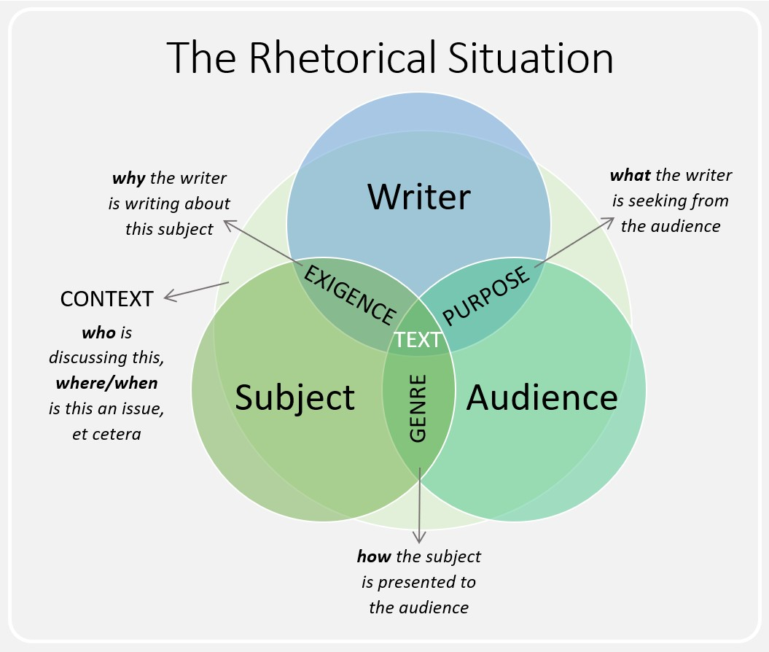

Slide 15
The sender:
He was not supported by the King.
He was not supported by his own party (The Conservative Party). (They still want Neville Chamberlain, if not, Secretary of State for Foreign Affairs Halifax)
He was supported by Labor party, though.
He was appointed this post because Labor party refused to join in the coalition government led by Chamberlain.
The receiver:
The House of Commons
For the whole nation and world to hear. Many people were interested in how Churchill would respond to World War II.

Slide 16
Overall Context:
On May 10, 1940, Germany launch its attack in the West of Europe.
On the same day, Winston became Prime Minister.
3 days later, first speech as Prime Minister to House of Commons
Purpose:
To ask the House of Commons for a vote of confidence in his new all-party government.
To inspire and build confidence in the British nation.

Slide 17
The tone?
The tone of “Blood, Toil, Tears and Sweat” changes though-out the speech.
When Churchill starts off, his tone is very informational and formal. He is explaining how he is making changes to his political cabinet and talking to the House members.
In the last two paragraphs the tone changes to hopeful and inspirational. He explains how England needs to win this war and give the nation hope in his leadership. The tone does stay serious during the entire speech.

Slide 18
Would you support him?
If you were in the House?
How did you feel?
Did he win your vote?
The reasons for making the speech a great success?
How to comment on his political legacy?

Slide 19
Language Appreciation
Rhetorical devices /stylistic elements (see the handout)

Slide 20
"Victory at all costs, victory in spite of all terror, victory, however long and hard the road may be….
It is to wage war, by sea, land and air, with all our might and with all the strength that God can give us;
"You ask, what is our policy?..."
"We have before us many, many long months of struggle and of suffering....“
I have nothing to offer but blood, toil, tears and sweat."..."
Notes:
The phrase is thought to be inspired by a speech by Italian revolutionary Giuseppe Garibaldi, "I offer hunger, thirst, forced marches, battle, and death."

Slide 21
"for without victory, there is no survival...."
“…a monstrous tyranny never surpassed in the dark and lamentable catalogue of human crime.”

Slide 22
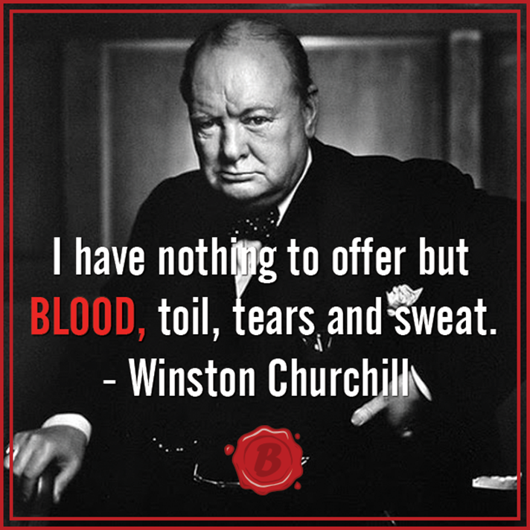
Read as though you were delivering the speech…
Read and find out the powerful lines that impressed you !

Slide 23
Analyze the whole speech
What is the message of each paragraph?
Read and find out.

Slide 24
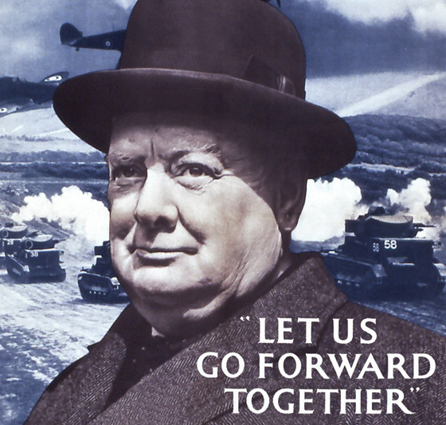
Let that be realized; no survival for the British Empire, no survival for all that the British Empire has stood for, no survival for the urge and impulse of the ages, that mankind will move forward towards its goal. But I take up my task with buoyancy and hope. I feel sure that our cause will not be suffered to fail among men. At this time I feel entitled to claim the aid of all, and I say, “come then, let us go forward together with our united strength.”)
Do you understand the first sentence?

Slide 25
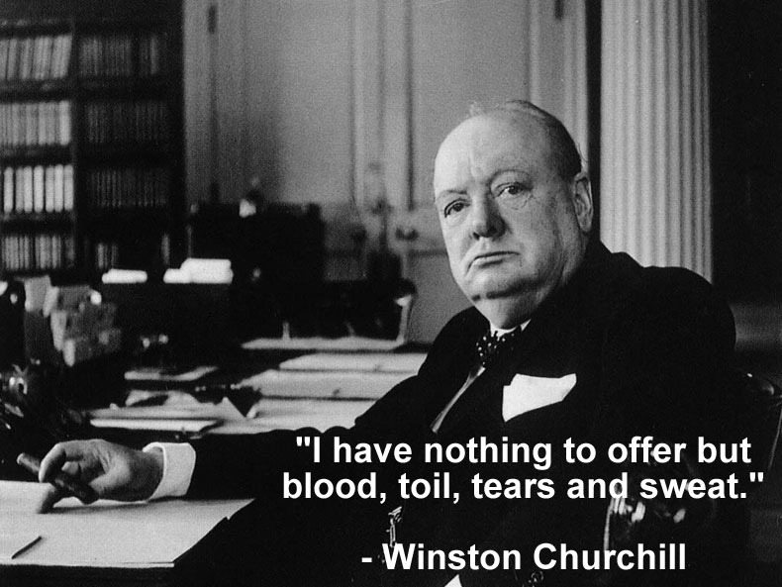
Listen to Churchill’s voice

Slide 26
Another famous Speech: We shall fight on the beaches

Slide 27
Winston Churchill to the House of Commons
on 4 June 1940
Content:
1. the success of the Germans in over-running the Netherlands, Belgium and France north of the Somme (索姆河),
2. the evacuation of the BEF (British expeditionary force) from Dunkirk
3. preparing the British to fight on alone, if necessary.
Churchill had to describe a great military disaster, and warn of a possible German invasion attempt, without casting doubt on eventual victory. Boost Morale.
The peroration (结束语): the best known part of the speech,
one of the finest oratorical moments of the war and of Churchill's career.

Slide 28
Watch the video
Which part of the speech has moved/impressed you most? Why?

Slide 29
I have, myself, full confidence that if all do their duty, if nothing is neglected, and if the best arrangements are made, as they are being made, we shall prove ourselves once more able to defend our island home, to ride out the storm of war, and to outlive the menace of tyranny, if necessary for years, if necessary alone. At any rate, that is what we are going to try to do. That is the resolve of His Majesty's Government – every man of them. That is the will of Parliament and the nation. The British Empire and the French Republic, linked together in their cause and in their need, will defend to the death their native soil, aiding each other like good comrades to the utmost of their strength.

Slide 30
Even though large tracts of Europe and many old and famous States have fallen or may fall into the grip of the Gestapo and all the odious apparatus of Nazi rule, we shall not flag or fail. We shall go on to the end. We shall fight in France, we shall fight on the seas and oceans, we shall fight with growing confidence and growing strength in the air, we shall defend our island, whatever the cost may be. We shall fight on the beaches, we shall fight on the landing grounds, we shall fight in the fields and in the streets, we shall fight in the hills; we shall never surrender, and if, which I do not for a moment believe, this island or a large part of it were subjugated and starving, then our Empire beyond the seas, armed and guarded by the British Fleet, would carry on the struggle, until, in God's good time, the New World, with all its power and might, steps forth to the rescue and the liberation of the old.

Slide 31
Reception
--It was recognized to be historic.
--One of Churchill's secretaries noted in his diary "A magnificent oration, which obviously moved the House”.
--A Conservative MP wrote in his diary "he was eloquent and oratorical and used magnificent English; several Labour members cried”.
-- A Labour MP, Josiah Wedgwood, friend and admirer of Churchill, wrote to him, "My dear Winston, that was worth 1,000 guns and the speeches of 1,000 years”.
Reaction from one listener
“Even repeated by the announcer (Note: BBC), it sent shivers (not of fear) down my spine. I think that one of the reasons why one is stirred by his Elizabethan phrases is that one feels the whole massive backing of power and resolve behind them, like a great fortress: they are never words for words' sake.”

Slide 32
The next year American journalist H. R. Knickerbocker wrote that its words "deserve to be memorized by us all", observing that "With Churchill's picture these words are placarded in homes and offices throughout the British Empire.”

Slide 33
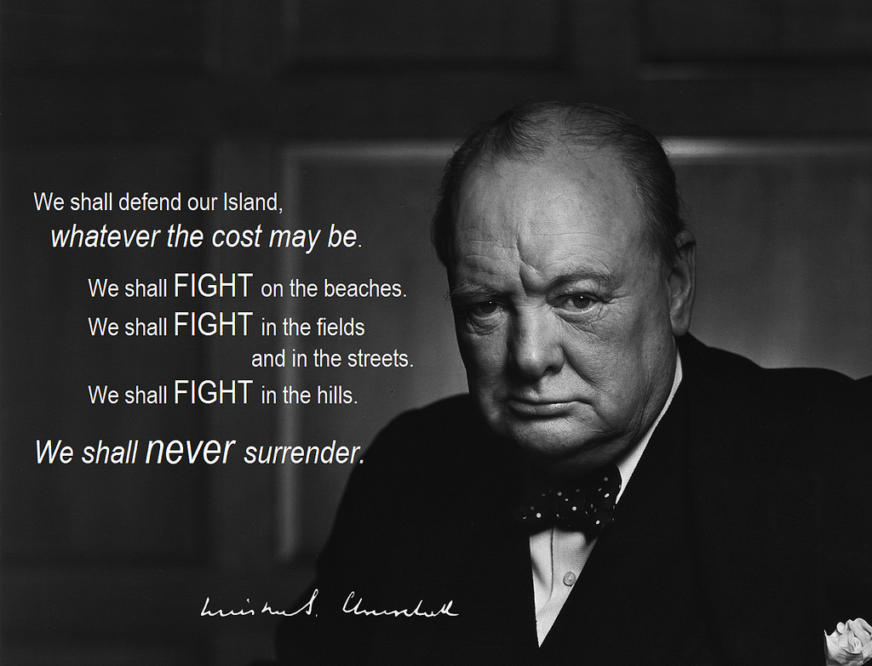

Slide 34
The finest hours
This speech, made after France had sought an armistice (停火，停战) on the evening of 16 June.
The peroration – quoted below – even at a moment of great apparent danger to British national survival talks not only of national survival and national interest, but of noble causes (freedom, Christian civilization, the rights of small nations) for which Britain was fighting and for which Churchill thought the United States should – and given time would – fight.

Slide 35
“....However matters may go in France or with the French Government or with another French Government, we in this island and in the British Empire will never lose our sense of comradeship with the French people. If we are now called upon to endure what they have suffered we shall emulate their courage, and if final victory rewards our toils they shall share the gains, aye. And freedom shall be restored to all. We abate nothing of our just demands—Czechs, Poles, Norwegians, Dutch, Belgians, all who have joined their causes to our own shall be restored.
What General Weygand has called the Battle of France is over ... the Battle of Britain is about to begin. Upon this battle depends the survival of Christian civilization. Upon it depends our own British life, and the long continuity of our institutions and our Empire. The whole fury and might of the enemy must very soon be turned on us. Hitler knows that he will have to break us in this island or lose the war. If we can stand up to him, all Europe may be freed and the life of the world may move forward into broad, sunlit uplands.
…

Slide 36
But if we fail, then the whole world, including the United States, including all that we have known and cared for, will sink into the abyss of a new dark age made more sinister (险恶的), and perhaps more protracted (拖延的), by the lights of perverted (堕落的) science. Let us therefore brace ourselves to our duties, and so bear ourselves, that if the British Empire and its Commonwealth last for a thousand years, men will still say, "This was their finest hour.””

Slide 37


